Slide 1
18CSE390T
Computer Vision
S2-Dynamic snakes and CONDENSATION

Slide 2
Dynamic snakes and CONDENSATION
In many applications of active contours, the object of interest is being tracked from frame to frame as it deforms and evolves.
In this case, it makes sense to use estimates from the previous frame to predict and constrain the new estimates.
One way to do this is to use Kalman filtering, which results in a formulation called Kalman snakes

Slide 3
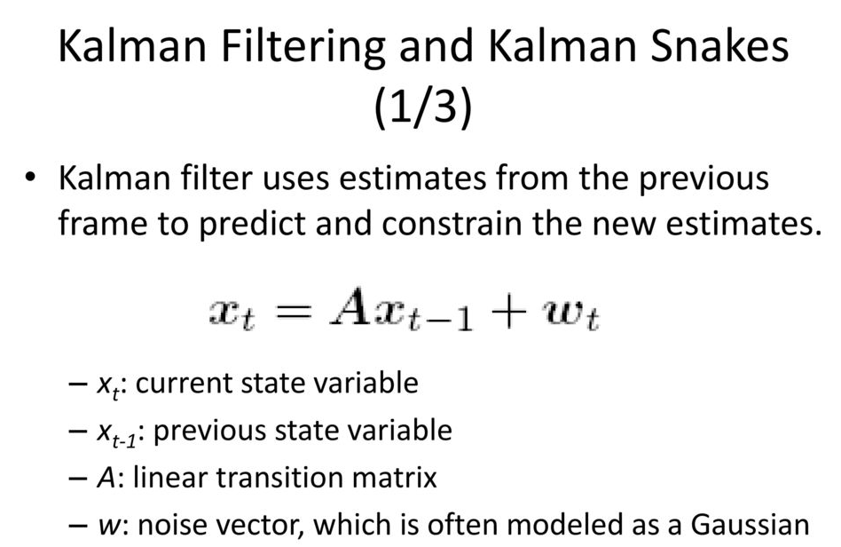
Dynamic snakes and CONDENSATION

Slide 4
The linear dynamic model causes a deterministic change (drift) in the previous estimate, while the process noise (perturbation) causes a stochastic diffusion that increases the system entropy (lack of certainty).
New measurements from the current frame restore some of the certainty (peakedness) in the updated estimate.
when tracking in clutter, a better estimate for the contour can be obtained if we remove the assumptions that the distribution are Gaussian, which is what the Kalman filter requires.

Slide 5
Particle filtering technique
Particle filtering techniques represent a probability distribution using a collection of weighted point samples
To update the locations of the samples according to the linear dynamics (deterministic drift), the centers of the samples are updated according to and multiple samples are generated for each point
These are then perturbed to account for the stochastic diffusion, i.e., their locations are moved by random vectors taken from the distribution of w.
Finally, the weights of these samples are multiplied by the measurement probability density, i.e., we take each sample and measure its likelihood given the current (new) measurements.

Slide 6
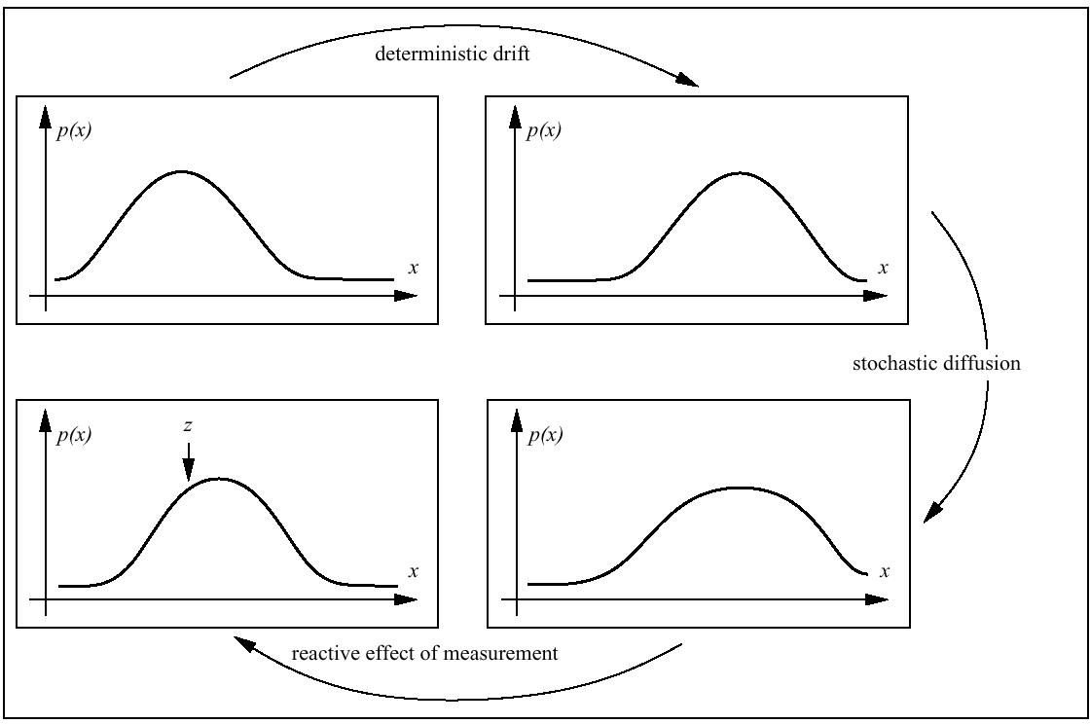
Particle filtering technique

Slide 7
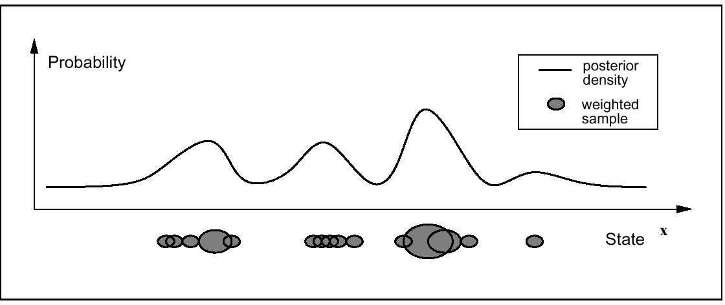
Particle filtering technique
Particle and weight representation of posterior density

